Slide 1

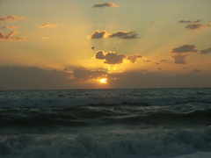


ACHILLE ANSELMO PhD
FLOW CYTOMETRY CORE

Slide 2



Slide 3
CYTOMETRY vs FLOW CYTOMETRY
Cytometry
Flow Cytometry
Localization of antigen is possible
Poor enumeration of cell subtypes
Limiting number of simultaneous measurements
No localization of antigens
Enumeration of subtypes via cell/size/granularity/ markers
Can look at numerous parameters simultaneously at high rate

Slide 4
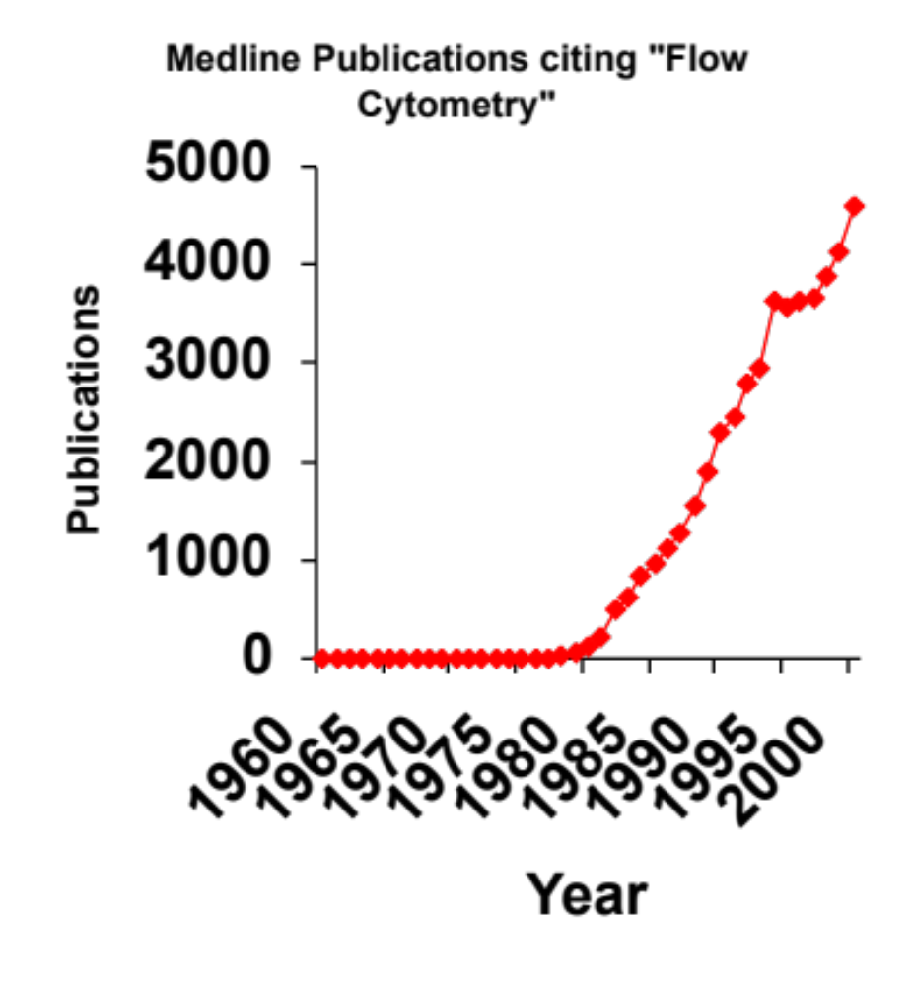
FLOW CYTOMETRY APPLICATIONS
It can be used for…
  Immunophenotyping
  DNA cell cycle/tumor ploidy
  Membrane potential
  Ion flux
  Cell viability
  Intracellular protein staining
  pH changes
  Cell tracking and proliferation
  Cell Sorting
  Redox state
  Enzyme activity
  Oxidative metabolism
  mRNA and micro RNA detection
  Soluble molecule detection
The use of flow in research has boomed since the mid-1980s
Notes:
With flow cytometry you will have an important tool in your hands for your research activity

Slide 5
FLOW CYTOMETER MAIN PARTS
Cells in suspension are brought in single line
a focused laser where they scatter light and emit fluorescence that is filtered and collected
then converted to digitized values that are stored in a file for analysis
Fluidics
Optics
Electronics

Slide 6
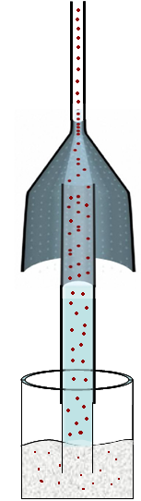
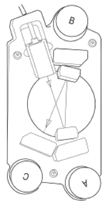
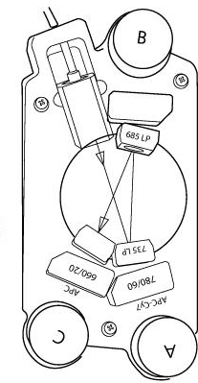
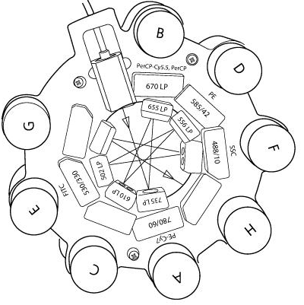
DIGITAL INSTRUMENTS FOR FLOW CYTOMETRY
Software
Pacific Blue
450/50
510/50
AmCyan

Slide 7

FLUIDIC PART
PRINCIPLE OF HIDRODINAMIC FOCUSING
10 psi
10 psi
10 psi
10.2 psi
10.4 psi
10.8 psi
Difference in pressure between sample and sheath
This will control sample volume flow rate
The greater the differential, the wider the sample core.
If differential is too large, cells will no longer line up single file
Results in wider CV’s and increase in multiple cells passing through the laser at once » » » Faster cell analysis BUT loss of resolution!!

Slide 8
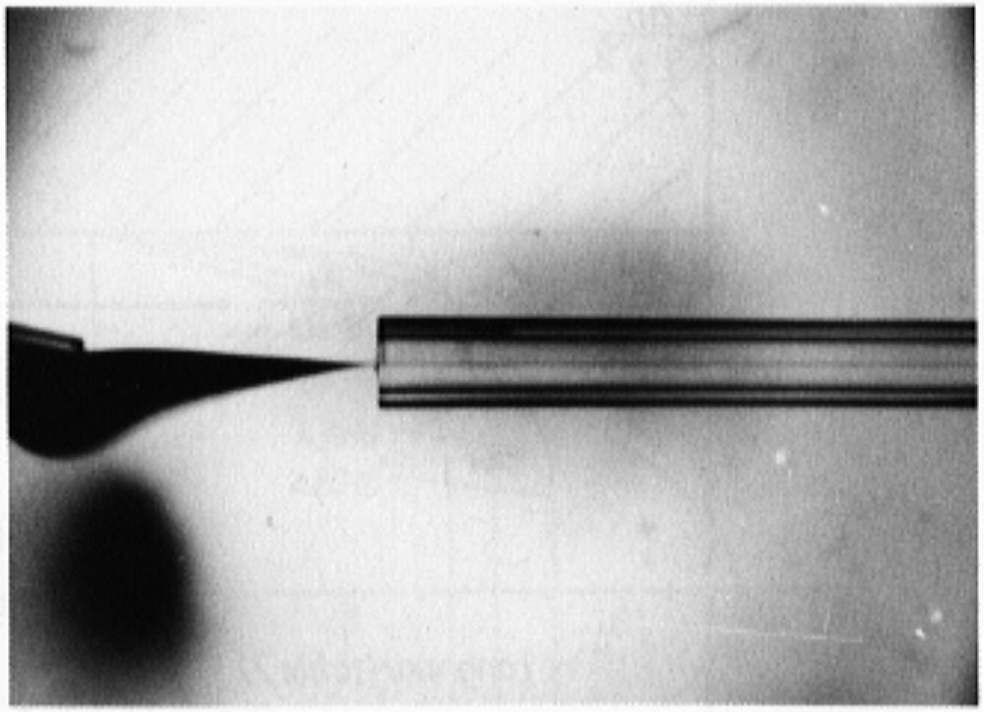
FLUIDIC PART
PRINCIPLE OF HIDRODINAMIC FOCUSING
Notes:
INk

Slide 9
OPTICAL PART
FSC
When light from a laser interrogates a cell, that cell scatters light in all directions.
Light that is scattered in the forward direction (along the same axis the laser is traveling) is detected in the Forward Scatter Channel.
The intensity of this signal has been attributed to cell size, refractive index (membrane permeability)

Slide 10

OPTICAL PART
SSC
Laser light that is scattered at 90 degrees to the axis of the laser path is detected in the Side Scatter Channel. The intensity of this signal is proportional to the amount of cytosolic structure in the cell (eg. granules, cell inclusions, etc.)
Laser Beam
FSC
Detector
Collection
Lens
SSC
Detector

Slide 11
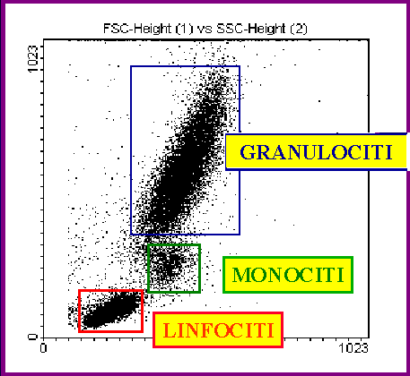
OPTICAL PART
FSC vs SSC in human leukocytes
SSC-A
Granulocytes
Monocytes
Lymphocytes
FSC-H

Slide 12
OPTICAL PART
FLUORESCENCE CHANNELS
As the laser interrogates the cell, fluorochromes on/in the cell (extrinsic or intrinsic) may absorb some of the light and become excited.
Fluorochromes leave their excited state and release energy in the form of a photon with a specific wavelength, longer than the excitation wavelength.
Emitted photons pass through the collection lens and are split and steered down specific channels with the use of filters.

Slide 13

OPTICAL PART
LONG PASS FILTERS
Transmit all wavelengths greater than specified wavelength
Example: 500LP will transmit all wavelengths greater than 500nm
Transmittance
400nm
500nm
600nm
700nm
BAND PASS FILTERS
Transmits a specific band of wavelengths
Example: 550/20BP Filter will transmit wavelengths of light between 540nm and 560nm (550/20 = 550+/-10, not 550+/-20)
Transmittance
400nm
500nm
600nm
700nm

Slide 14
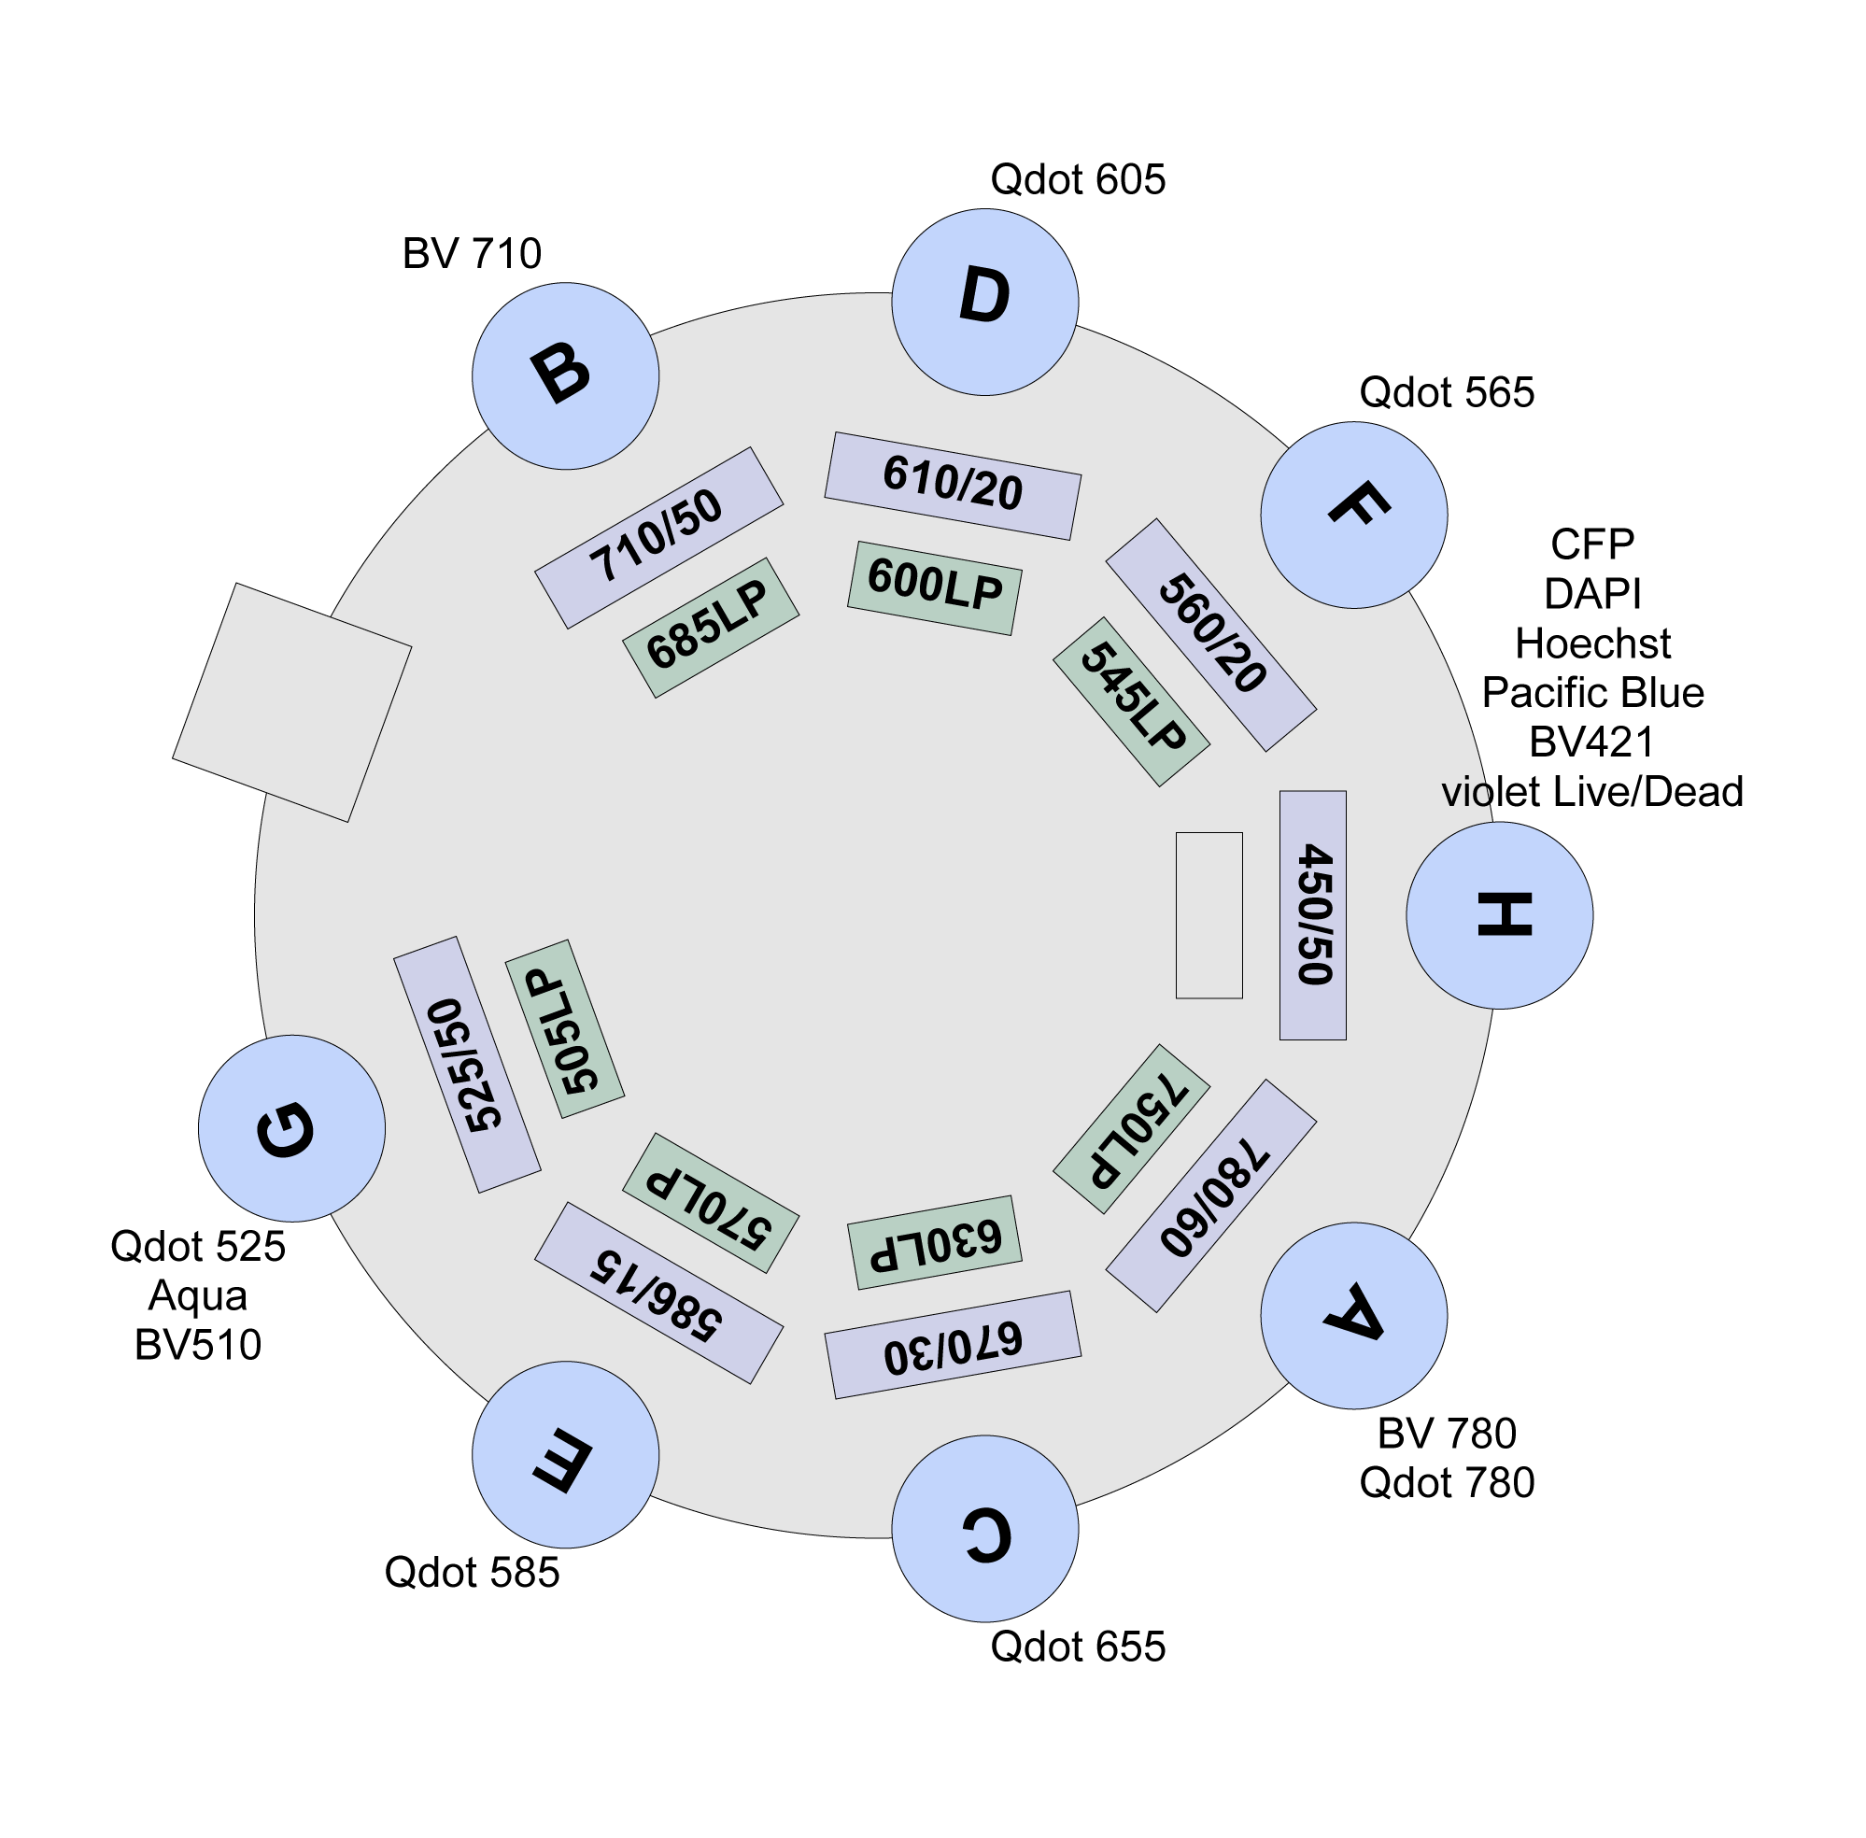
DIGITAL INSTRUMENTS FOR FLOW CYTOMETRY
OPTICAL BENCH BASED ON REFLECTION
405nm
Notes:
The disposition of the filters has to be very rigorous

Slide 15
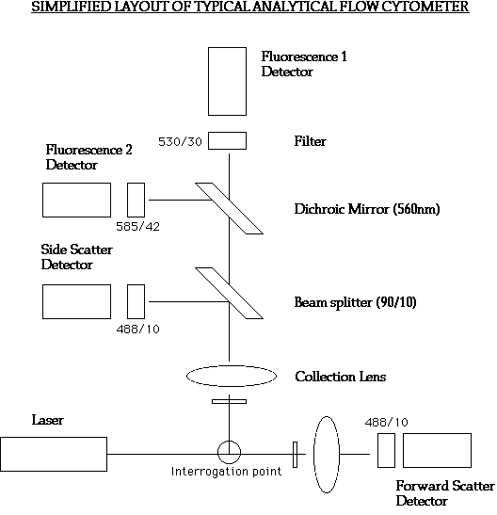
ANALOGICAL INSTRUMENTS FOR FLOW CYTOMETRY
OPTICAL BENCH BASED ON RIFRACTION
488nm
Notes:
THE SIGNAL IS WEAKNED

Slide 16
OPTICAL PART
OPTIC DETECTORS
There are two main types of photo detectors used in flow cytometry:
  Photodiodes
    Used for strong signals, when saturation is a potential problem (eg. FSC detector)
  Photomultiplier tubes (PMT)
    More sensitive than a Photodiode, a PMT is used for detecting small amounts of fluorescence emitted from fluorochromes.

Slide 17
ELECTRONIC PART
STEPS FROM OPTIC TO ELECTRONIC CONVERSION OF THE SIGNAL
1 Photon recovery from a single event in a time window
2 Conversion into current
3 Current transfer through an amplifier
4 Conversion into a voltage pulse
5 Conversion into a digitized value
6 Software visualization

Slide 18
ELECTRONIC PART
PHOTON RECOVERY
    As the cell passes into the laser, an event window opens
    More light is scattered as the cell moves into the center of the laser (maxima)
    As the cell leaves the laser, less and less light is scattered
    After a set amount of time, the window closes until another event enters the beam

Slide 19
ELECTRONIC PART
STEPS FROM OPTIC TO ELECTRONIC CONVERSION OF THE SIGNAL
1 Photon recovery from a single event in a time window
2 Conversion into current
3 Current transfer through an amplifier
4 Conversion into a voltage pulse
5 Conversion into a digitized value
6 Software visualization

Slide 20
ELECTRONIC PART
STEPS FROM OPTIC TO ELECTRONIC CONVERSION OF THE SIGNAL
1 Photon recovery from a single event in a time window
2 Conversion into current
3 Current transfer through an amplifier
4 Conversion into a voltage pulse
5 Conversion into a digitized value
6 Software visualization

Slide 21
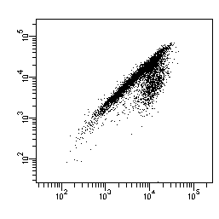
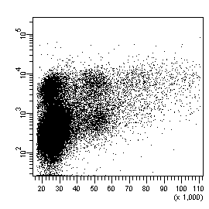
ELECTRONIC PART
LINEAR AND LOG AMPLIFIERS
When the current exits the detector, it passes through either a linear or log amplifier where it is converted it into the voltage pulse.
Intensity of the voltage can be adjusted by amplifying it on a linear scale or converting it to a logarithmic scale
  The use of a log amp is beneficial when there is a broad range of fluorescence as that may need to be compressed (this is generally true of most biological distributions)
FITC-A
Dead cell Dye
2N
4N
6N
8N
  Linear amplification is used when there is not such a broad range of signals (e.g. in DNA analysis and calcium flux measurement)
PCM1-FITC
PI-A

Slide 22
ELECTRONIC PART
STEPS FROM OPTIC TO ELECTRONIC CONVERSION OF THE SIGNAL
1 Photon recovery from a single event in a time window
2 Conversion into current
3 Current transfer through an amplifier
4 Conversion into a voltage pulse
5 Conversion into a digitized value
6 Software visualization

Slide 23
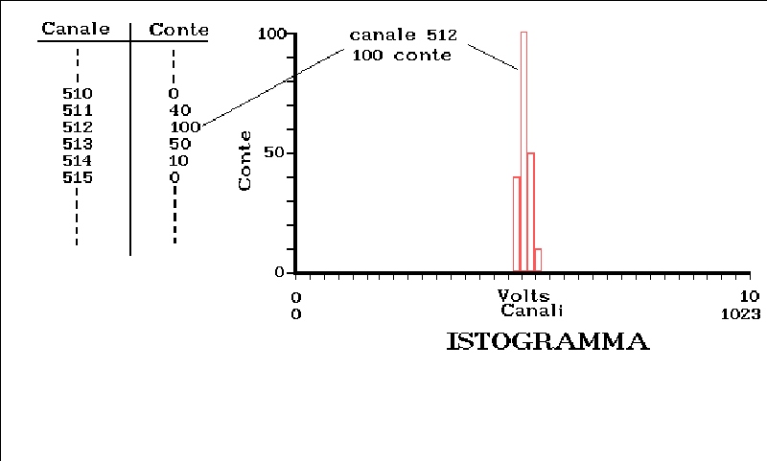
ELECTRONIC PART
Channels of count
The signal resulting in the fluorescence emission is measured in volts, then the software moves each voltage pulse into a channel of count (from 0 to 262144) to allow a graphic rapresentation of the obtained data

Slide 24
ELECTRONIC PART
STEPS FROM OPTIC TO ELECTRONIC CONVERSION OF THE SIGNAL
1 Photon recovery from a single event in a time window
2 Conversion into current
3 Current transfer through an amplifier
4 Conversion into a voltage pulse
5 Conversion into a digitized value
6 Visualization of data

Slide 25
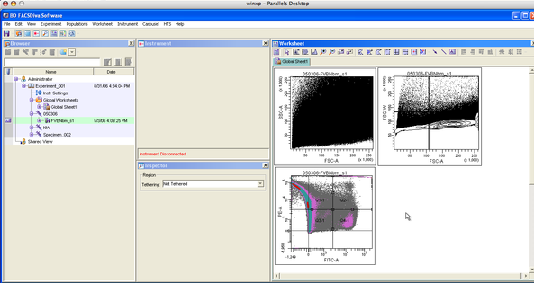
ELECTRONIC PART
SOFTWARE AVAILABLE:
DIVA
FLO JO
CELL QUEST
MOD-FIT
(proliferation and
cell cycle analysis)

Slide 26
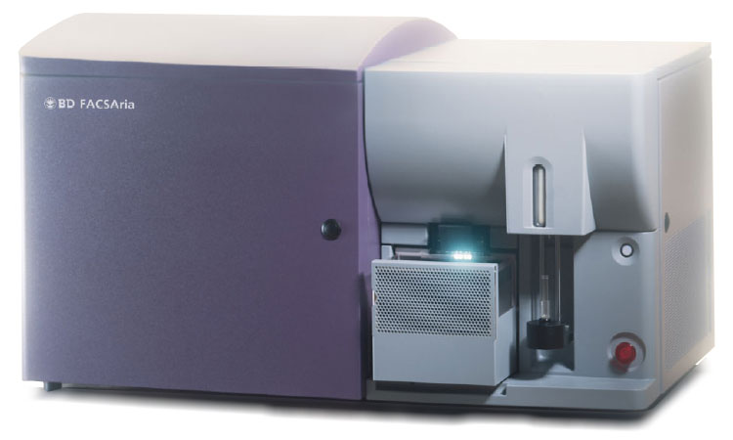
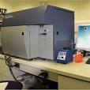
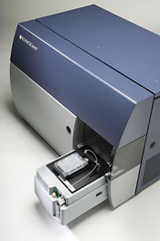

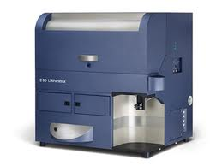
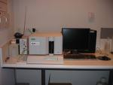
FLOW CYTOMETRY UNIT EQUIPMENT
FACS ARIA III CELL SORTER
4 LASERS (405nm/488nm/561nm/633nm)
FACS CANTO
2 LASERS (488nm/633nm)
FACS CANTO II-HTS
3 LASERS (405nm/488nm/633nm)
FACS CALIBUR
BIOPLEX
2 LASERS (488nm/633nm)
2 LASERS (532nm/635nm)
LSR FORTESSA
4 LASERS (405nm/488nm/561nm/633nm)

Slide 27


Slide 28
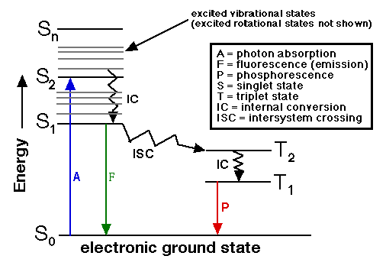
Fluorescence
Jablonski Diagram
Notes:
I want just tell you that fluorescence is a rapid phenomen that take place when the electron moves from a ground state to an excited state and quickly lose energy reaching again the ground state. The phosporescence is a slow phenomenon as compared to fluorescence accompained by heat release.

Slide 29
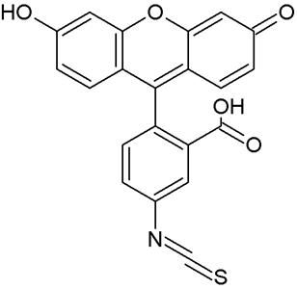


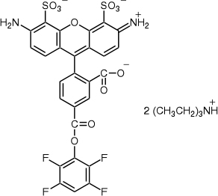
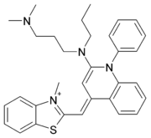
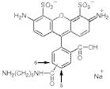
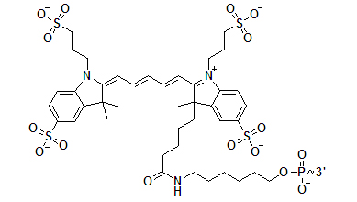
Fluorophores
Notes:
Fluorophores are a world of moleculesmolecules derived from nautral elements with peculiar chemical structure such as aromatic rings or conjugated double bound that allows the phenomen of fluorescence

Slide 30
FLUOROPHORES CLASSIFICATION
Existing fluorescent probes fall into four classes:
1) Large protein-based molecules (e.g., phycobiliproteins)
2) Inorganic fluorescent nanocrystals (e.g., quantum dots)
3) Small organic dyes (e.g.,fluorescein)
4) Organic polymers (e.g. BVs)

Slide 31
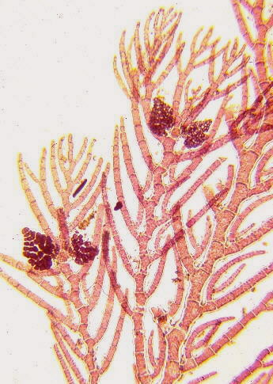

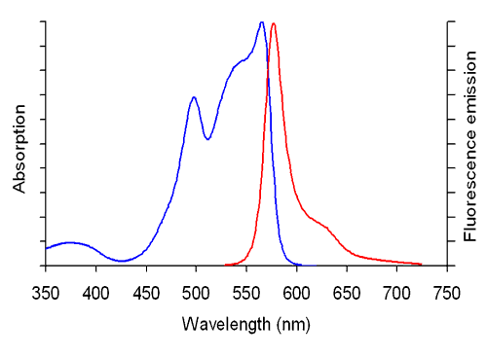
FLUOROPHORES CLASSIFICATION
Large protein-based molecules
PMT
Phycoerithrin
chemical structure
emission
575nm
Rhodophyta,
excitation
BLUE LASER
488nm
YELLOW GREEN
LASER
561nm

Slide 32

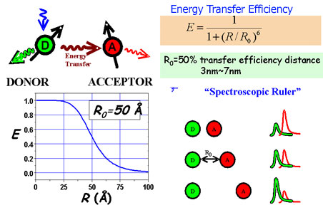
FLUOROPHORES CLASSIFICATION
TANDEM DYES
Based on FRET (fluorescence resonance energy transfer) between two dyes, donor and acceptor.
If the dyes are separated by a large distance (larger than ~10nm), then there is little
interaction between them and the donor will emit photons upon its excitation by laser.
We can use FRET in tandem fluorophores to have more possible emission using few lasers
absorption
absorption
emission
emission
PE free
APC free

Slide 33

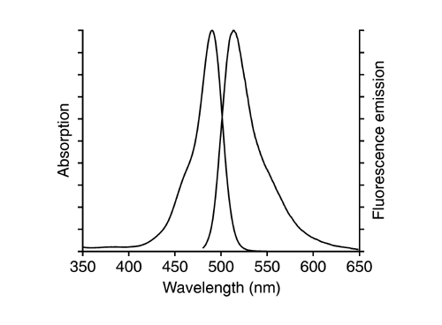
FLUOROPHORES CLASSIFICATION
Small organic dyes
PMT
Fluorescein isothiocyanate
chemical structure
emission
525nm
Syntetic molecules
excitation
BLUE LASER
488nm

Slide 34
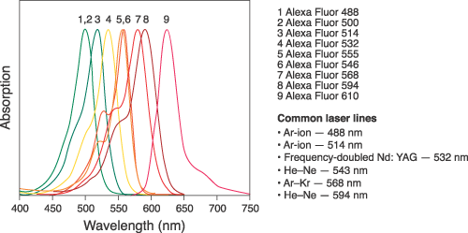
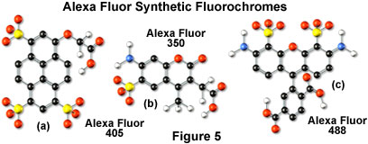
FLUOROPHORES CLASSIFICATION
Organic dyes
PMT
Emission to different
wavelenghts
excitation
excitation
excitation
VIOLET LASER
405nm
BLUE LASER
488nm
NEAR ULTRA VIOLET LASER
350nm

Slide 35
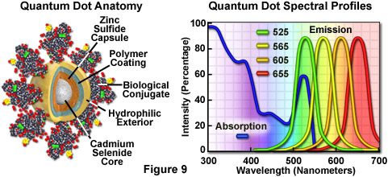
FLUOROPHORES CLASSIFICATION
Inorganic fluorescent nanocrystals
Quantum dot are biologically active particle that ranges in size from 10 to 15 nanometers
Quantum dots have an absorption spectrum that increases steadily with decreasing wavelength. Also in contrast, the fluorescence emission intensity is confined to a symmetrical peak with a maximum wavelength that is dependent on the dot size, but independent of the excitation wavelength.

Slide 36
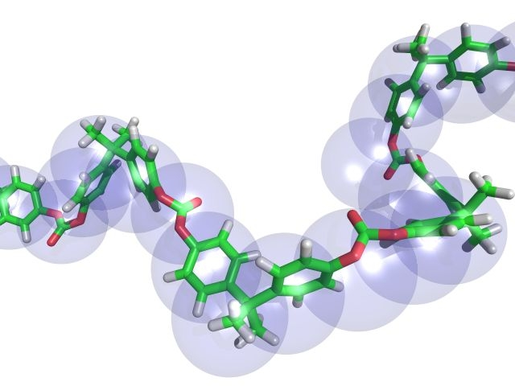


FLUOROPHORES CLASSIFICATION
Organic polymers
PMT
Brilliant Dyes
chemical structure
emission
These polymers possess both a high energy absorption capacity (extinction coefficient), and high emission efficiency (quantum yield). When conjugated to antibodies, they bring dramatic improvements in brightness and signal-to-noise ratio on labeled cells.
excitation
VIOLET LASER
405nm
UV LASER
355nm
BLUE LASER
488nm

Slide 37
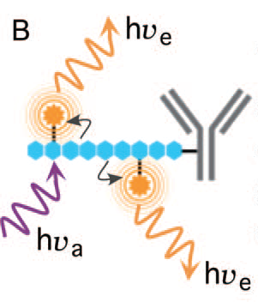
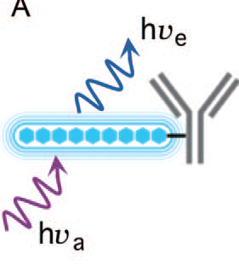
BRILLIANT DYES STRUCTURE AND FEATURES
These conjugated polymers are comprised of alternating single and double bonds and aromatic units.
This repeating bond structure creates a continuous π-orbital system and extended electronic delocalization.
The Brilliant fluorescent probe resulted from chemical modifications to a polymer that yielded the appropriate excitation spectrum, water solubility, conjugation ability, and minimal nonspecific binding. Additional violet-excited fluorescent probes with differing emission spectra have been developed by creating tandem dyes of Brilliant conjugated with more traditional fluorophores such as Cy3 (the BV570 tandem dye).
Because the number of sites for acceptor dye attachment is controlled synthetically these BV tandems exhibit far less lot-to-lot variation in the ratio of donor to acceptor dye, and thus less spectral variability, than PE and similar protein based tandems. Because the number of dye attachment sites is fixed, repeated optimization of dye stechiometry is not necessary.
Stephen C. De Rosa. Cytometry Part A 81A:445 2012
Pratip K. Chattopadhyay et al. Cytometry Part A 81A:456 2012

Slide 38
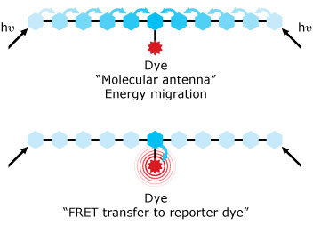
…MORE ABOUT BRILLIANT
Dye | Ex (nm) | Em (nm) | e (M-1 cm-1) | Quantum Yield (%) | MW (kD) | Type of Dye
BUV395™ | 348 | 395 | 1000000 | 90 |  | Base polymer
BUV496™ | 348 | 496 | 1400000 | 62 |  | Tandem Dye (BUV395+acceptor dye)
BUV563™ | 348 | 563 | 1500000 | 35
BUV661™ | 348 | 667 | 1400000 | 37 |  | Tandem Dye (BUV395+acceptor dye)
BUV737™ | 348 | 737 | 1500000 | 14 |  | Tandem Dye (BUV395+acceptor dye)
BUV805™ | 348 | 805 | 1500000 | 4 |  | Tandem Dye (BUV395+acceptor dye)
BV421™ | 407 | 421 | 2300000 | 80 | 60-80 | Base polymer
BV480™ | 407 | 480 | 1400000 | 70 |  | Base polymer
BV510™ | 405 | 510 | 550000 | 55 | 60-80 | Base polymer
BV570™ | 407 | 570 | 2200000 | 8 | 60-80 | Tandem Dye (BV421+Cy3)
BV605™ | 407 | 602 | 2200000 | 32 | 60-80 | Tandem Dye (BV421+Cy3.5)
BV650™ | 407 | 650 | 2200000 | 17 | 60-80 | Tandem Dye (BV421+DY-610)
BV711™ | 407 | 711 | 2200000 | 18 | 60-80 | Tandem Dye (BV421+DY-682)
BV786™ | 407 | 786 | 2200000 | 8 | 60-80 | Tandem Dye (BV421+DY-752)
BB515™ | 490 | 515 | 11000000 | 70 |  | Base polymer
Notes:
BV are new dyes composed by a chain of aromatic rings and in some cases by acceptor dyes that give rise to different emission wavelenghts. So at the moment are available brilliant dyes excited by uv laser violet laser and blue lasers. All these dyes are under patent so its very difficult to find information regarding the chemical structure and the quantum yield and molar ext coeff .
This is a summary of what is now available online and as you can see there are no precise information on the MW of BV and also on the caracteristic of bightness for BB and also BUV. As you can see the brighter dye is BV421 while BV510 and 570 is the less bright. Moreover these two dyes are single polimer while the others are tandem with precise site of bound between donor and acceptor

Slide 39

BRILLIANT VIOLET FILTERS EQUIPMENT
Notes:
Here you can se the filter setting that we suggest to you for a good detection of these dyes please keep in mind that despite the dyes are excited by violet lasers you will need to compensate most of them with other fluorocromes like PE Percp APC due to the similar emission wavelenght

Slide 40
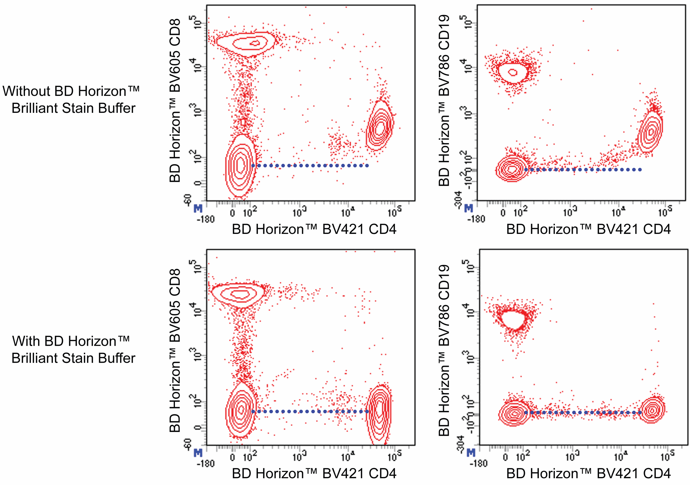
BRILLIANT STAIN BUFFER
“Improves staining quality when multiple BD Horizon Brilliant™ polymer conjugates are used in the same experiment”
“When using only one BD Horizon Brilliant reagent in an experiment, the Brilliant Stain Buffer is not needed.”
Notes:
When you buy one antibody conjungated with brilliant dye BD provdesa brilliant stain buffer, following an easy protocol you can stain your samples minimizing the overlap between two or more brillinat dyes present in the same tubes

Slide 41
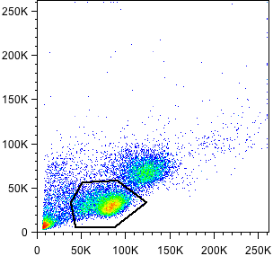
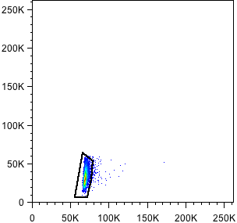
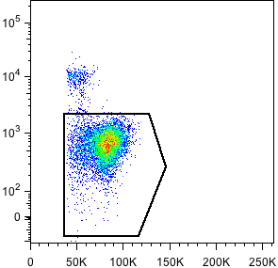
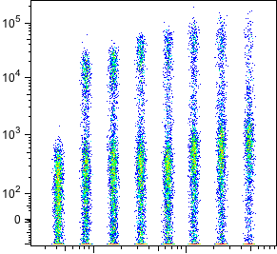
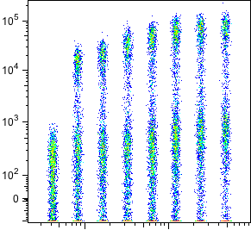
SOME EXAMPLES OF BRILLIANT DYES STAINING
CD8 BV786 (RPA-T8) titration
Aquavid-A
SSC-A
SSC-A
FSC-A
SSC-W
FSC-A
HBSS+ 2%FCS
Brilliant stain buffer
21.5%
12.4%
29%
μl
0
2.5
5
μl
0
2.5
5
0.08
0.16
0.32
0.65
1.25
0.08
0.16
0.32
0.65
1.25
Notes:
However during simple titrazion experiments in our lab we have noted that also in a single staining a simple buffer like HBSS+2%FCS led to unespected results. In this case for example we have titrated CD8 BV786 and starting from 5 ul the amount suggested in the datasheet not only we observed and in crease of the background but also a strong reduction of the positive events as compared to the more diluited samples. These phenomenon didn’t occur in presence of BV buffer and in this experimental condition the % of positive events werei n any cases higher than the other buffer

Slide 42
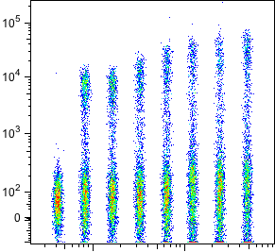
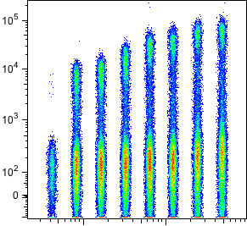
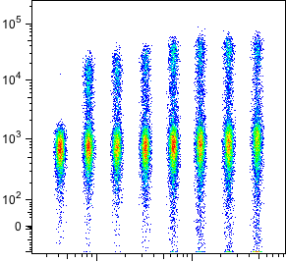
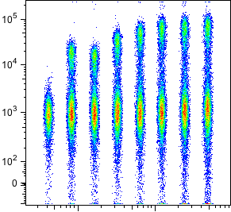
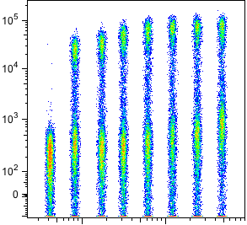
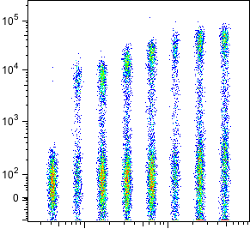
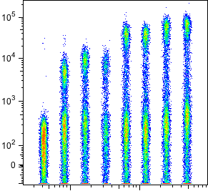
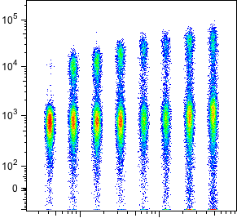


SOME EXAMPLES OF BRILLIANT DYES STAINING
CD8 BV711
CD8 BV650
CD8 BV570
CD8 BV510
CD8 BV421
10.7%
20%
16.5%
23.6%
HBSS+ 2%FCS
32.8%
21.5%
Brilliant stain buffer
Notes:
Same experiment have been performed on the same antibody conjugated with the other BVs and the strange phenomen i described before occured randomnly

Slide 43




… AND BRILLIANT BLUE CONJUGATES TITRATION
CD8 BB515
CD4 BB515
HBSS+ 2%FCS
Brilliant stain buffer

Slide 44

RESOLUTION MATRIX
Notes:
Permette di capire quanto dell’anticorpo primario entra in un canale dopo l’aggiunto di un fluorocromo secondario.

Slide 45



















BUV496 SPILLOVER
BUV395
BUV563
BUV661
BUV737
BUV805
CD8 BUV 496
CD8 BUV 496
CD8 BUV 496
CD8 BUV 496
CD8 BUV 496
BV 421
BV 510
BV 605
BV 650
BV 711
BV 785
CD8 BUV 496
CD8 BUV 496
CD8 BUV 496
CD8 BUV 496
CD8 BUV 496
CD8 BUV 496
A 488
PerCP
PE
PE-CF594
7-ADD
PE-CY7
CD8 BUV 496
CD8 BUV 496
CD8 BUV 496
CD8 BUV 496
CD8 BUV 496
CD8 BUV 496
A 647
A 700
CD8 BUV 496
CD8 BUV 496
Notes:
Permette di capire quanto dell’anticorpo primario entra in un canale dopo l’aggiunto di un fluorocromo secondario.

Slide 46
BRILLIANT DYES CONCLUSIONS
Titrate Brilliant dyes before using them
Use Brilliant stain buffer in order to optimize the staining
Check the spillover between Brilliant Dyes and
other fluorophores
Notes:
These are very preliminary results, We are in contact with BD in order two obtain more information of these dyes and we are going to use other stain buffer and repeat these experiments but what i want to suggest to you is that its very important at the moment titrate and use BV buffer

Slide 47
EVALUATION OF FLUOROPHORE BRILLIANCE
E= Molar extinction coefficient
Probability that one photon shooted to a molecule is truly
adsorbed.
It is a measurement of how strongly a chemical species absorbs light
at a given wavelength.
Q= Quantum yield
Measure of the efficiency with which absorbed light produces some effect.
Quantum yield can be defined by the equation:
Q= photons emitted/photons absorbed.
0≤Q≤1
Notes:
The bightness of each fluorophore is definied by two main aspect

Slide 48

































































































EVALUATION OF FLUOROPHORE BRILLIANCE: F/P ratio
IgG-Cy3
Referred to the only Ab
at the excitation λ of the Dye
Referred to the only Ab
Correction factor
OD280 – (OD550 X CF)
Antibody amount (Protein)=
Ab MW
(mole/dm³)
1,4
Constant
150000 for IgG
Referred to the Dye
at its excitation λ
OD550
Dye amount=
ε
(mole/dm³)
Dye molar extinction coefficient
Dye
F/P=
Ab
Notes:
Optic density
In flow you might use for your experiments just the pure dye , this is the case of PI or CFSE butalso flurophores conjiugated with antibodies , in this case another important paraments that has to be consider is the F/P ratio

Slide 49



GENETICALLY ENCODED FLUORESCENT PROTEINS
Fused to N- or C- terminal of a target protein without affecting its biological function
Notes:
L’aequora victoria ha dato la la Green Fluorescent Protein che ha un picco di eccitazione a 395nm ma la sua ingegnerizzazione ha portato successivamente alla eGFP che ha un picco di eccitazione a 488nm. Dalla Discosoma invece è nata inizialmente la DSREd che ha un picco di eccitazione a 558 e una emissione a 583 dalla quale poi è stata formata la RFP che ha uno shift di eccitazione ed emissione di 25 nm tuttavia ed è nata per ridurre i tempi lunghissimi di maturazione della Dsred ( tetramero) di circa 10 ore ma questo è andato a discapito del coefficiente di estinzione molare e dell’efficienza quantica ecco perche poi sono state create molte altre proteine del rosso

Slide 50

PROPERTIES OF THE BEST FP VARIANTS
Nathan Shaner et al; Nature Biotech 2004
Notes:
Evoluzione sul tempo di maturazione passando dalla rfp al tomato e poi al cherry. Come si può notare l’m cherry è quello che ha il tempo di maturazione piu breve è questo a parità di fotostabilità la rende migliore del tomato che seppur piu brillante ha un peso molecolare che è il doppio dell’m cherry e di conseguenza potrebbe questo andare ad alterare la funzionalità della proteina taggata. Nel nostro istituto prediligIamo mcherry per i recettori chemochinici come CX3CR1 proprio per non rischiare di modificarne la funzionalità inclusa l’interazione con il ligando.
Prima usavamo la eGFP quando non avevamo il laser yellow green nel banco ottico.

Slide 51

MAIN FACTORS THAT INFLUENCE FLUORESCENCE
Effect of solvent:
a) presence of ions ( i.e. Annexin V staining)
b) PH influence
Comparison of pH-dependent fluorescence of the
Oregon Green 488 ( ), carboxyfluorescein ( ) and Alexa Fluor 488 ( ) fluorophores.
Fluorescence intensities were measured for equal concentrations of the three dyes using excitation/emission at 490/520 nm.
2) Quenching effect:
reduction of emission due to the interaction of the fluorophore with other elements of
the system.
Concentration of fluorophores
b) Presence of oxigene derivates
c) Temperature

Slide 52

MAIN FACTORS THAT INFLUENCE FLUORESCENCE
3) Photobleaching:
photochemical destruction of a fluorophore.
nature of fluorophores (tandem dyes are particularly affected)
b) intensity of the source of excitation
c) viscosity of the environment
Photobleaching resistance of the red-fluorescent Alexa Fluor 647, Alexa Fluor 633, PBXL-3 and Cy5 dyes and the allophycocyanin fluorescent protein, as determined by laser-scanning cytometry. EL4 cells were labeled with biotin-conjugated anti-CD44 antibody and detected
by Alexa Fluor 647, Alexa Fluor 633, PBXL-3, Cy5 or allophycocyanin (APC) streptavidin.
Scan durations were approximately five minutes apiece, and each repetition was started immediately after completion of the previous scan. Data are expressed as percentages derived from the mean fluorescence intensity (MFI) of each scan divided by the MFI of the first scan.
Data contributed by Bill Telford, Experimental Transplantation and Immunology Branch, National
Cancer Institute.

Slide 53
THE BEST FLUOROPHORE:
High Molar extinction coefficient
High quantum yield
Photostability
Reduced quenching effect
5) Non influence in viability of cells

Slide 54






BIBLIOGRAPHY
Improved monomeric red, orange and yellow fluorescent proteins derived from Discosoma sp. red fluorescent protein
Nathan C Shaner, Robert E Campbell, Paul A Steinbach, Ben N G Giepmans, Amy E Palmer & Roger Y Tsien

Slide 55
USEFUL LINKS
https://www.thermofisher.com/it/en/home/life-science/cell-analysis/labeling-chemistry/fluorescence-spectraviewer.html
http://www.biolegend.com/spectraanalyzer
https://www.bdbiosciences.com/sg/research/multicolor/spectrum_viewer/index.jsp

Slide 56


Slide 57



Slide 58


CELL STAINING PROCEDURES FOR IMMUNOPHENOTYPING
DIRECT STAINING
1 STEP STAINING: Ab (monoclonal or polyclonal) directly conjugated with fluorophores

Slide 59



CELL STAINING PROCEDURES FOR IMMUNOPHENOTYPING
2 steps: primary purified antibody
secondary antibody coniugated
STAINING APPROACHES
ANTIGEN
PRIMARY ANTIBODY
SECONDARY ANTIBODY
DYE
3 steps: primary purified antibody
secondary antibody biotinilated
streptavidin coniugated
ANTIGEN
PRIMARY ANTIBODY
SECONDARY ANTIBODY
BIOTINILATED
DYE
STREPTAVIDINE
Advantage and Limitations
Streptavidine-Biotin

Slide 60
SIGNAL AMPLIFICATION
HOME MADE APPROACH
LASER
PMT
FILTERS
Biotin
Dye
X
Streptavidine
Y
X>Y
Fluorophore
Cell surface
Antigen

Slide 61



SIGNAL AMPLIFICATION
COMMERCIAL APPROACHES
ZENON technology:
INCREASE MOLAR RATIO FAB: FLUOROPHORE
NB: this is an useful method in case of mouse anti mouse antibodies
Blood monocytes
Spleen macrophages
Mouse IgG2a
Anti agrin IgG2a
Zenon alexa 647
Notes:
Steric hindrance

Slide 62







SIGNAL AMPLIFICATION
COMMERCIAL APPROACHES
Christmas tree approach
R2
R3
R1
CD71 FITC
R4+R5
R1
Ter-119PE
R2
R3
R4+R5
Agrin33 biotinilated
Streptavidine APC
Three cycles of amplification

Slide 63
FALSE POSITIVE EVENTS
DOUBLETS DISCRIMINATION
H = height
A
H
A = area
VOLTAGE
W= width
W
TIME
Logical gate
R1 and R2 and R3
R3
R2
R1
SSC-A
SSC-A
FSC-A
FSC-A
SSC-W
FSC-W
Notes:
Loss

Slide 64
FALSE POSITIVE EVENTS
DEAD CELLS EXCLUSION
Dead cells can nonspecifically bind monoclonal antibody conjugates, potentially leading to false positive events, particularly when cell frequencies are low.
DYE OPTIONS
1) DNA intercalating dyes (Propidium Iodide, 7AAD, SYTOX etc.)
2) Phosphatidylserine binding dyes (Annexin V)
3) Amino Reactive Viability Dyes (ViD, Zombie etc)
These dyes recognize late apoptotic events. They were found to be stable with no loss in fluorescent intensity when treated with permeabilization or fixation reagents.
Since these dyes are excited by a variety of lasers and emit light energy at a variety of detectors, they can be easily incorporated into different panel strategies.
Notes:
Discutere di necrosi late apoptosis and early apoptosis

Slide 65




FALSE POSITIVE EVENTS
DOUBLETS DISCRIMINATION AND CELL DEAD EXCLUSION
Murine splenocytes
P1
P1
SSC-A
VID
P2
FSC-A
FSC-A
P2
P3
P4
FSC-A
SSC-A
P3
FSC-W
SSC-W

Slide 66
NEGATIVE CONTROLS
Staining of a negative cellular population
Immunoglobulin isotype control: immunoglobulin with irrilevant specificity conjugated with the same fluorophore of the related antibody
Blocking antibody control: staining with the unconjugated antibody followed by the staining with the conjugated ones
Staining with isotype control followed by the staining with the secondary antibody directly conjugated
(for 2 steps staining)

Slide 67
NEGATIVE CONTROLS
Fluorescence Minus One (FMO) approach:
Mario Roederer
Current protocols in Cytometry 2002

Slide 68
NEGATIVE CONTROLS
Fluorescence Minus One (FMO) approach:
Sample:
Hamster anti-human IgG 1 CD1a-APC
Mouse anti-human IgG1 HLA DR-FITC
Mouse anti-human IgG 2a CD80-BV510
Mouse anti-human IgG 2b CD86-PE
Negative control A:
Hamster IgG1-APC
Mouse anti-human IgG1 HLA DR-FITC
Mouse anti-human IgG 2a CD80-BV510
Mouse anti-human IgG 2b CD86-PE
Negative control B:
Hamster anti-human IgG 1 CD1a-APC
Mouse IgG1-FITC
Mouse anti-human IgG 2a CD80-BV510
Mouse anti-human IgG 2b CD86-PE
Negative control C:
Hamster anti-human IgG 1 CD1a-APC
Mouse anti-human IgG1 HLA DR-FITC
Mouse IgG 2 a-BV510
Mouse anti-human IgG 2b CD86-PE
Negative control D:
Hamster anti-human IgG 1 CD1a-APC
Mouse anti-human IgG1 HLA DR-FITC
Mouse anti-human IgG 2a CD80-BV510
Mouse IgG 2b-PE

Slide 69






BIBLIOGRAPHY
UNIT 1.14 Compensation in Flow Cytometry
Mario Roederer
Published Online: 1 DEC 2002

Slide 70
BEFORE STARTING…….
Check on spectra viewer the excitation and emission wavelenghts of
your fluorophores
Verify the equipment of your instrument in term of lasers and optical
bench
Choose the brighter fluorophore for the antibody who recognizes the
less expressed antigen
Exclude dead cells and doublets from the analysis in order to minimize false positive events
Use the right negative control (FMO plus isotype control)
Notes:
Point out your same crucial tool for a good multiparametric analysis

